Slide 1
AI-Powered Task Management System

Slide 2

01
Problem Definition & Data Sourcing
02
Preprocessing & Feature Engineering
Project Overview: Key Phases
03
Model Development & Tuning
04
Evaluation & UI Deployment
05
Challenges & Roadmap

Slide 3
Problem Statement
Design and develop an intelligent task management system that leverages NLP and ML techniques to automatically classify, prioritize, and assign tasks to users based on their behavior, deadlines, and workloads.
Goal
Automate task prioritization using natural language processing (NLP) and machine learning (ML) to improve workflow efficiency.
Scope
Utilize real-world issue tracking data from Apache Hadoop's JIRA to train and evaluate the models.
Outcome
Deliver a deployable AI-powered system capable of classifying and prioritizing tasks based on content, user patterns, and workload.

Slide 4
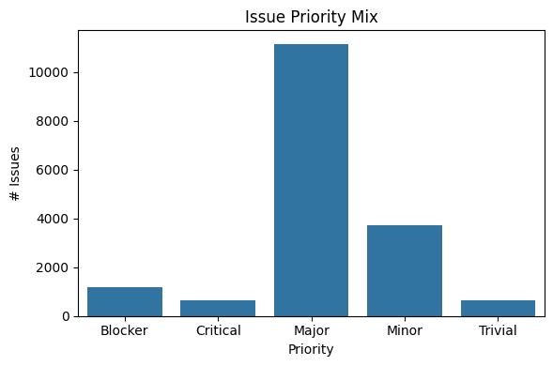
Dataset Description: Apache Hadoop JIRA Issues
Collected ~17,000 issues from Apache Hadoop JIRA using a REST API with pagination.
Data Sourcing
Dataset Dimensions
Total rows: 17,263
Columns:5
summary: Short title of the issue
description: Full issue details
priority: Categorical (e.g., Major, Minor, Critical)
status: Current status of the ticket (Open, Resolved, Closed, etc.)
created: Timestamp when the issue was logged
.

Slide 5

Data Cleaning and Preprocessing
Cleaned data: handled nulls, duplicates
Preprocessing:
Cleaned summary and description using spaCy
Combined into a new field: input_text
Applied:
Lemmatization
Tokenization
Stopword Removal
Saved cleaned CSV: jira_issues_cleaned.csv
.
Initial Observations
Models showed a strong bias toward 'Medium' priority due to class imbalance in training data.

Slide 6
Feature Engineering & Baseline Models
TF-IDF Features
Generated textual features from issue data using TF-IDF to transform input_text into sparse vector space.
Model Training
Trained Naive Bayes and SVM classifiers. Evaluation focused on accuracy, precision, recall, and F1-score.

Slide 7
Week 3: Advanced Modeling & Tuning
Model Enhancements
Added Random Forest and XGBoost classifiers with hyperparameter tuning via GridSearchCV.
Class Imbalance Handling
Applied SMOTE to balance class distribution and reduce model bias toward majority class.
Best Model Performance
The best-performing model was a tuned Random Forest, achieving 62% accuracy and an F1-score of 0.61.

Slide 8
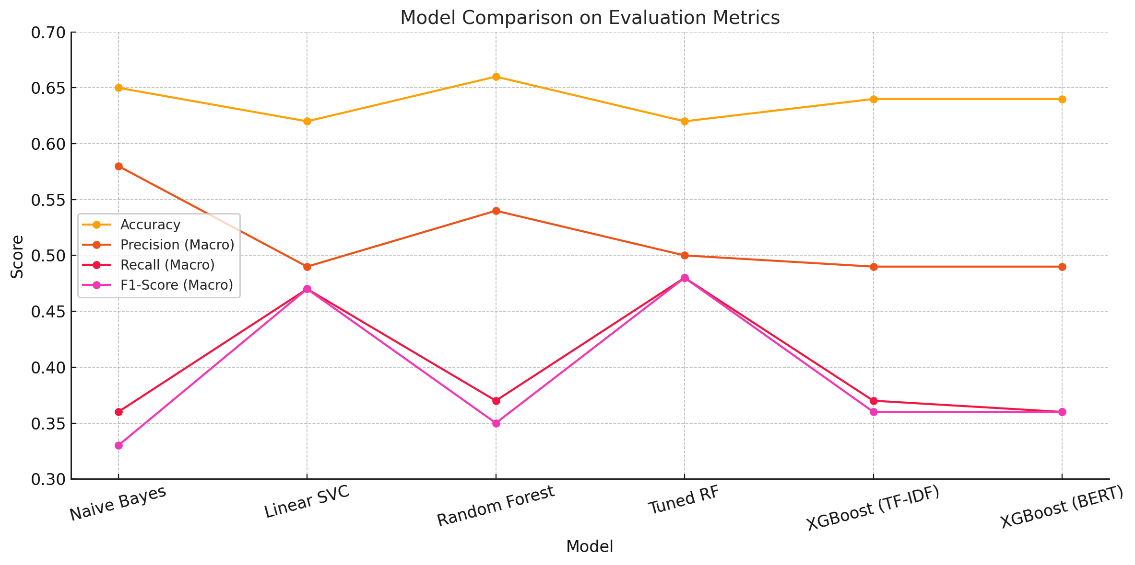
]

Slide 9
Week 4: Finalization & Deployment
Model Export
Exported best model with `joblib` and created performance evaluation reports including confusion matrix.
UI Development
The frontend UI is built using Flask (v2.3.3) as a lightweight web framework, serving static templates and enabling interaction with a RESTful backend.
Public Testing
Deployed interface via public link to gather user feedback and assess real-world prediction outcomes.

Slide 10
Challenges and Key Learnings
Data Imbalance
The dominance of the 'Medium' class affected the recall for 'High' and 'Low' priorities, limiting model effectiveness.
Model & Resource Demands
Training tree models and experimenting with BERT embeddings were time-intensive and required significant compute resources.
Skill Growth
Gained practical experience with SMOTE, model tuning, performance metrics, and live UI deployment tools like Flask

Slide 11

Planned Improvements
Integrate BERT embeddings with Random Forest; explore ensemble methods for better generalization.
Future Enhancements
Enable real-time feedback loops and automatic retraining for continuous model refinement.

Slide 12
Open for Discussion
Questions or Feedback?
Thank You!
Feel free to reach out via LinkedIn, GitHub, or email. Your feedback is valuable for improving our AI prioritization model.

